Slide 1

Data state of mind
MaryJo Webster CAR Editor maryjo.webster@startribune.com @MaryJoWebster

Slide 2

Data is a source
Notes:
The #1 thing to take away from this session is that you should treat data the same way you treat human sources.
The database you get from a public agency is just like a human source. It can answer questions, raise questions, point you in the right direction, or even mislead you if you’re not careful in not only how you ask the question, but also in how you interpret the answer.
It can be a tipster or it could be the key source in your story or it could just offer some background or context.

Slide 3
Same sourcing rules apply...
Is this source reliable? And how do you know that?
What can and can’t this source tell us?
Verify what this source tells you
Make sure you use more than one source
Notes:
The best thing you can do to backstop your analysis is to use the same rules
especially – is this source reliable? and how do you know that?
data should NEVER be your only source; and you should always have human sources review your analysis results.

Slide 4

If you ask wrong question, you’ll get wrong answer
Notes:
When talking to humans, you might get a wrong answer if you phrase your question in a way that they don’t quite understand. Data works the same way – the difference is that you are asking your question in “computer speak”, so it’s much easier for us to trip up – since that’s not our native tongue. To get around this, it’s a really good idea to ask lots and lots of questions – framed in different ways. Luckily, data will sit and answer questions for hours and hours on end, without getting annoyed by you.

Slide 5
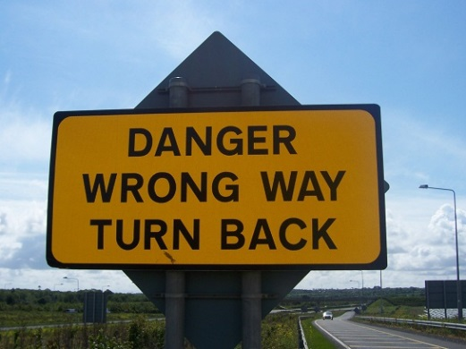
If something doesn’t seem quite right, check it out
Notes:
There are all kinds of ways your analysis results can end up with big outliers or unusual results – and the majority of the time it’s either the result of faulty data to begin with or some error in the analysis. This session isn’t long enough to get into the various scenarios, but the bottom line is that if something seems too good to be true, it probably is. And, as I said before, checking your results with human sources is always a very good way to backstop your work.
A paper in Florida published a story saying the Llasa Appso was the most common dog breed in their county based on an analysis of dog license data. The next day they had to run a correction. The reporter had sorted the spreadsheet incorrectly.

Slide 6

Data can only tell you what it knows
Notes:
A reporter at the PiPress asked for data on foster care homes that had had their licenses suspended or revoked. She asked that the data include the reason the license was pulled. DHS kind of freaked out on us. We got their data people to have a phone conference with us and then they explained that their database doesn’t include the reason – that information only existed in their paper records. The database was essentially an index of their paper records.

Slide 7

It will often lead you to more questions…
Notes:
The analysis and reporting phase of the story should be one – with the reporter going back and forth between data and human sources. Oftentimes, the humans will lead the reporter to something in the data that they hadn’t thought to look for before.

Slide 8

But shoe-leather reporting
is as important as ever…
Data should not be your only source

Slide 9
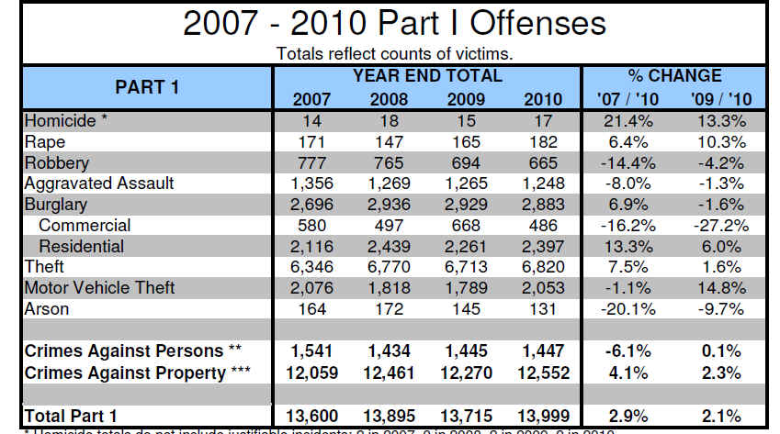
Aggregate
or
Summary
Notes:
The questions you can ask data are dependent on the depth of the data you get.

Slide 10
Questions we can ask the aggregate data?
Which crime(s) had biggest increase or decrease across the three years
Compare property crime to crimes against persons

Slide 11
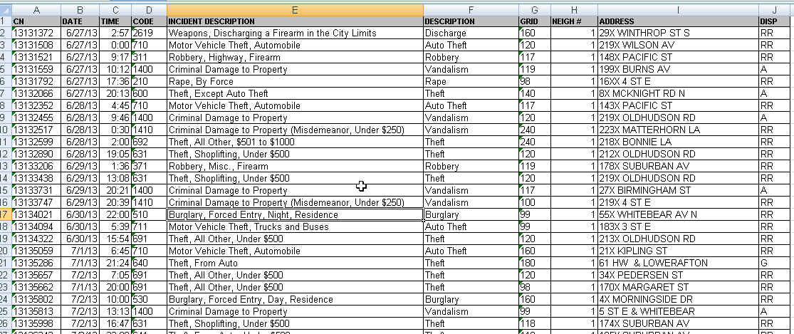
Raw data

Slide 12
Questions for the raw data?
Which neighborhood had biggest increase in crime?
Were some parts of the city more prone to certain types of crimes than other neighborhoods?
Is there a time of day or day of week when more crimes are reported?
Per capita crime rates
You can turn this into a map!
You can ask for all the crime reports – not just the Part 1 crimes

Slide 13
Examples of what you can do with a data state of mind

Slide 14
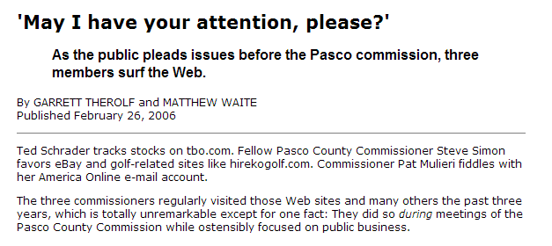

Q: What are commissioners doing on their laptops during meetings?
Data: Internet history for all county employees
Notes:
BE A BETTER WATCHDOG: Our job as watchdogs of government requires us to find things that government officials won’t just hand to us in a press release. And to find those things, investigative journalists have long followed the mantra of having a “documents state of mind.” Now that so much government information is stored electronically, we need to have a “data state of mind.” A reporter who can analyze this data is able to open a lot more doors.
This is one of my favorite examples. Reporters at the St. Petersburg Times were wondering what the Pasco County Commissioners were doing during commission meetings. All of them had their heads down, consumed by their laptops. By asking a few questions, the reporters found out that those computers were connected to the county’s network. And the county kept Internet history logs, specific to each user. And yes, those were public records. So the reporters requested the history logs, filtered it down to the commissioners’ user IDs, then filtered it down to the days and times when meetings occurred. Then they looked at which sites the commissioners were visiting and wrote this great – yet rather simple – story telling the readers which sites those commissioners were visiting. And readers could quickly ascertain that it sure didn’t seem like official govt business.

Slide 15
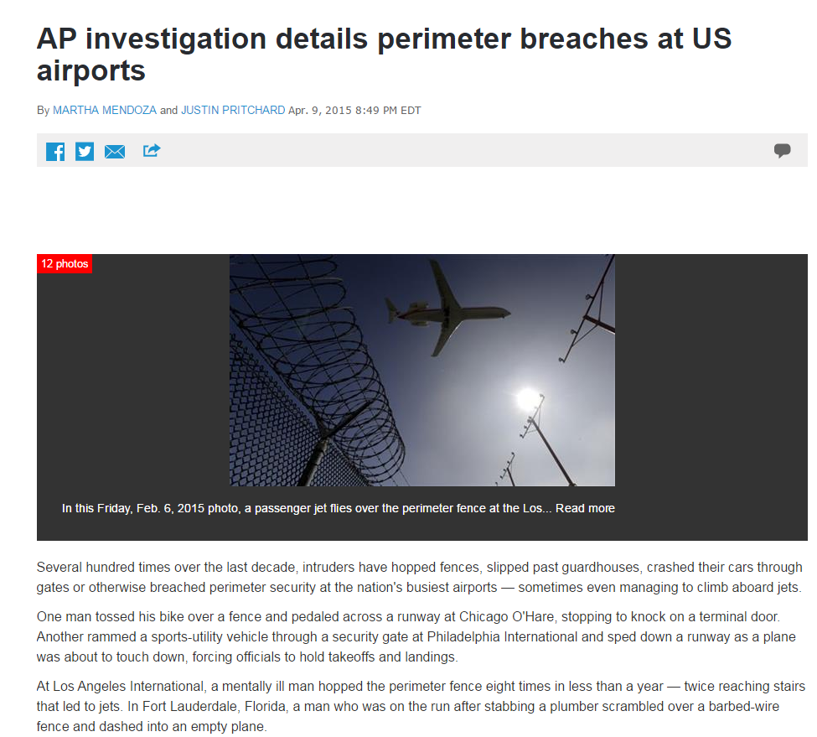
Q: How often do perimeter breaches occur at airports?
Notes:
The AP's analysis was prompted by a high-profile breach last spring that resulted in one 15-year-old's improbable journey to Hawaii. Yahya Abdi climbed a fence at San Jose International Airport, hoisted himself into a jet's wheel well and survived an almost six-hour flight. Abdi, who lived with his father and stepmother, said he was trying to get back to his mother, a refugee in Ethiopia.
Afterward, San Jose airport spokeswoman Rosemary Barnes said breaches are more common than people realize.
Through public records requests, news archive searches and interviews, the AP created the most comprehensive public accounting of perimeter security breaches from January 2004 through January 2015 at San Jose and the nation's 30 busiest airports. The analysis excluded incidents inside the airport, such as when a passenger went unscreened through a security checkpoint or walked out the wrong exit door.

Slide 16
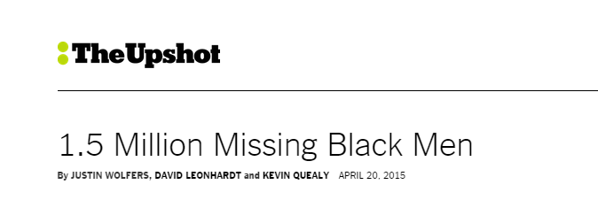
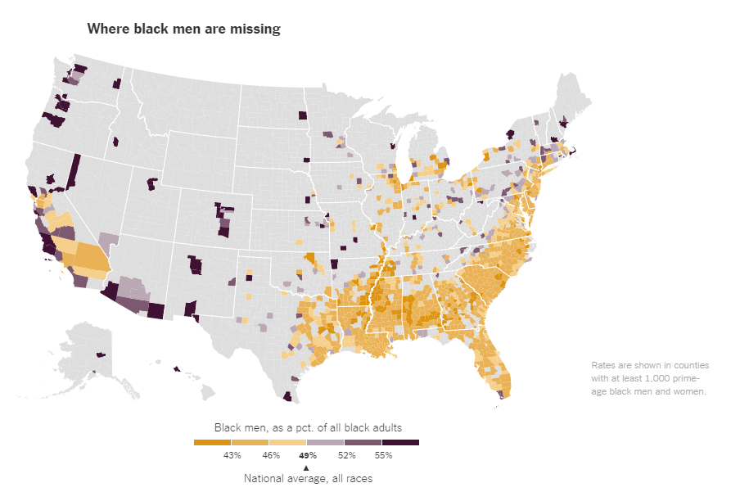
Q: Can we measure the much-discussed topic of prime-age black men missing from society?
Notes:
Upshot used 2010 Census data to analyze one of the key underlying issues that affects so many other things in the black community – the “missing” black men. The piece starts with the assumption that in any given place men should make up roughly half of the regular “prime age” population (excluding those in prison or in the military). Same should hold true when you zoom in on a specific racial group. But their analysis found that this doesn’t hold true for the black population. There are about 1.5 million FEWER black men than women in the “prime” age group of 25 to 54. And they found places – such as Fergusen, Mo – where this gap was particularly stark.

Slide 17
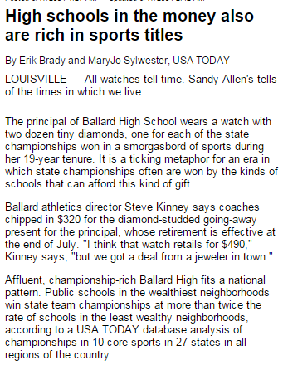
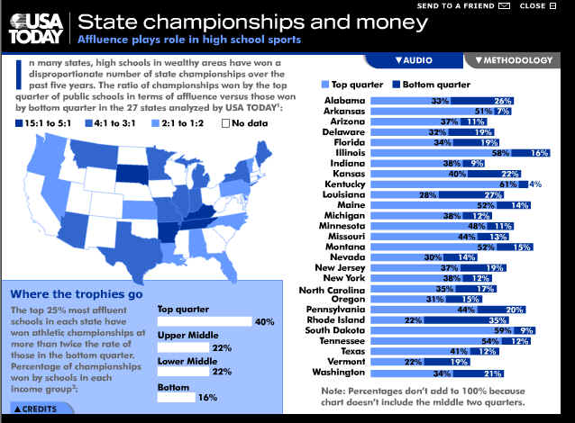
Q: Do “rich” high schools win more state championships?
Notes:
We started with a common question (or perhaps assumption) – Do “rich” high schools win more sports titles than those in lower-income neighborhoods?
The trick was figuring out how to measure that. Cause it’s not something that someone keeps track of. There wasn’t a single database out there that would answer this question.
So we built our own. Since this was such a large endeavor, we chose to “sample” the country by strategically picking states (various parts of the country, various population sizes) and then sticking to only those sports that are common in pretty much every state. We collected state championship results from the 13 states we chose – in some cases, it came to us on paper or in PDF. Then we pulled data on schools from the US Dept of Education (including percent of children on free/reduced lunch) and then we pulled census data on the neighborhoods where the schools are located. We put all the demographic data together to build a sort of “index” judging the wealth/poverty standing for each school and then grouped the schools into quartiles based on that income standing. We tallied up the number of championships and found that the schools in that highest income quartile won championships at twice the rate of those in the lowest quartile.

Slide 18
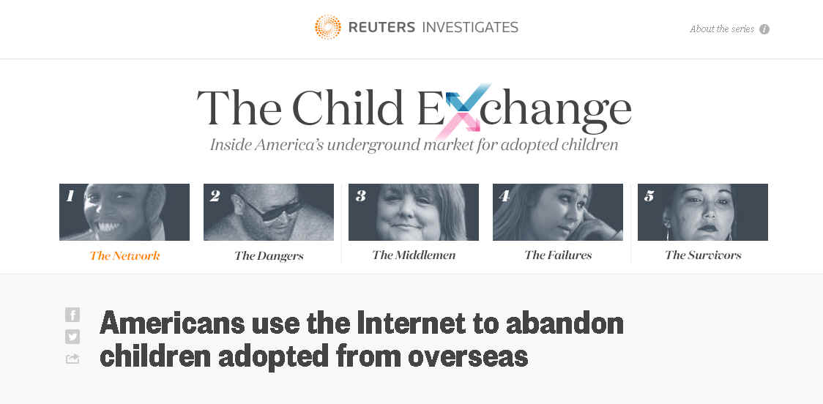
Q: Can we “track” the buying and selling of foreign adoptees in online discussion boards?
Notes:
This is one of the more interesting uses of data analysis that I’ve seen. The story uncovers an online network where foreign-born adoptees are bought and sold. To really understand the network, Reuters scraped messages from various discussion boards and turned that into a database. That enabled them to find numerous postings where it was clear the same child was being sold for a second or third time. It made for a very powerful story, combined with impressive shoe-leather reporting that included amazing interviews with some of the buyers and sellers.

Slide 19
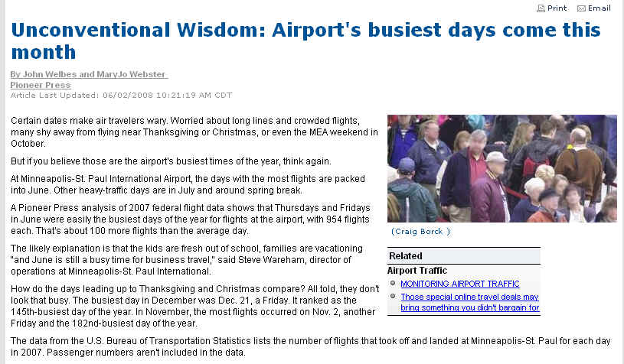
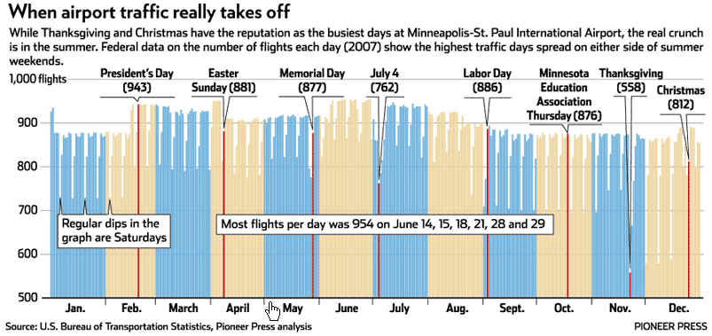
Q: Are the holidays REALLY the busiest time of year at the airport?
Notes:
Data analysis is really the best way you can bust “myths” or common misperceptions that linger out there. John Welbes, a former Pioneer Press reporter, had heard over and over from airport workers that the holidays really are NOT the busiest time of the year, even though the TV stations tout that every year. He pulled data from the FAA on all flights coming in and out of MSP each day (over a number of years), then we averaged it out by day and found those airport workers were right. The busiest week of the year? Beginning of June – right when school lets out.

Slide 20
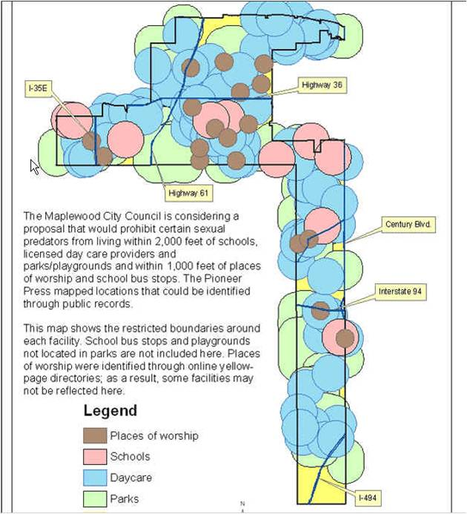

Q: What would happen if the city enacted this ban on where sex offenders could live?
Data: collected either addresses or GIS maps with locations of schools, parks, daycares and places of worship
Notes:
Several years ago, a suburb of St. Paul was considering an ordinance that would’ve prohibited where certain sex offenders could live. The proposal called for banning them from living within 2,000 feet of daycares, schools, parks and playgrounds. And within 1,000 feet of places of worship and bus stops. We used various datasets to find the locations of these places in that city (we didn’t do bus stops or playgrounds) and then used special GIS tools to analyze what portion of the city was left after the restrictions were applied. This map was the result – showing only two small sections of the city unaffected: one was an industrial park in the northern part of the city and the other was under a major interstate highway in the lower part of the city. The following week, the city council tabled the plan and hasn’t brought it back since.

Slide 21
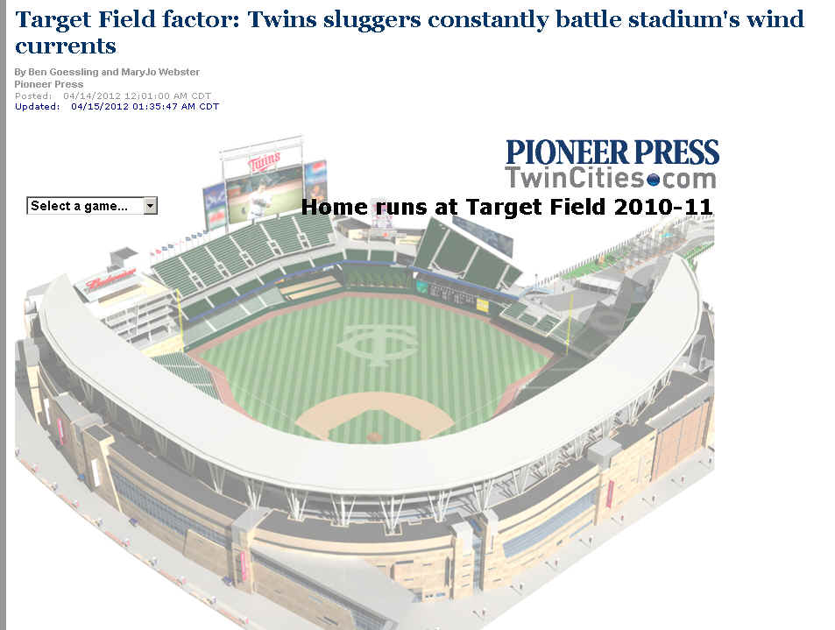
Q: Is the weather a factor in why the Twins haven’t been hitting very many homeruns?
Data:
Hitting data by team for each game
Weather data by day and start time of game
Notes:
IS IT TRUE?
Journalists spend a lot of time writing about whether something is true or not. Most of the time we end up with a lot of “he said she said” -- various people or experts batting around the various opinions or theories.
But sometimes journalists could measure whether something is true or not, using data.
At the Pioneer Press we were getting ready for the third season that the Minnesota Twins baseball team would play in their new stadium, Target Field. The big question everybody was talking about was why the Twins had such a horrible record hitting homeruns those first two seasons. There were tons of theories floating around. But the players all talked about one – the weather.
The lead baseball writer came to me and asked if we could figure out whether there was any truth there. We recruited a meteorologist as an advisor and he pointed us to downloadable weather files that had records for every day – taken from a weather station near the stadium. Then we downloaded all kinds of hitting data and married the two together.

Slide 22
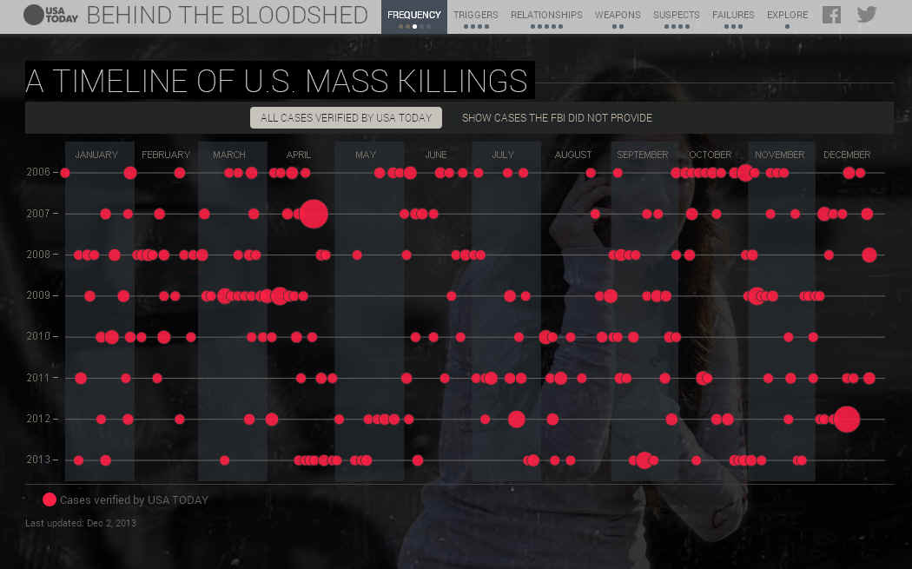

Q: How often do mass killings occur?
Data:
FBI data
Media reports
Local police records
Notes:
Data is frequently used for putting big events into context. This USA Today project, “Behind the Bloodshed” sought to answer the question – “How often do mass killings occur?”
The answer: more often than you’d expect based on the news.
They built this database, starting with incomplete FBI data and then adding other incidents based on news stories and local police reports.

Slide 23
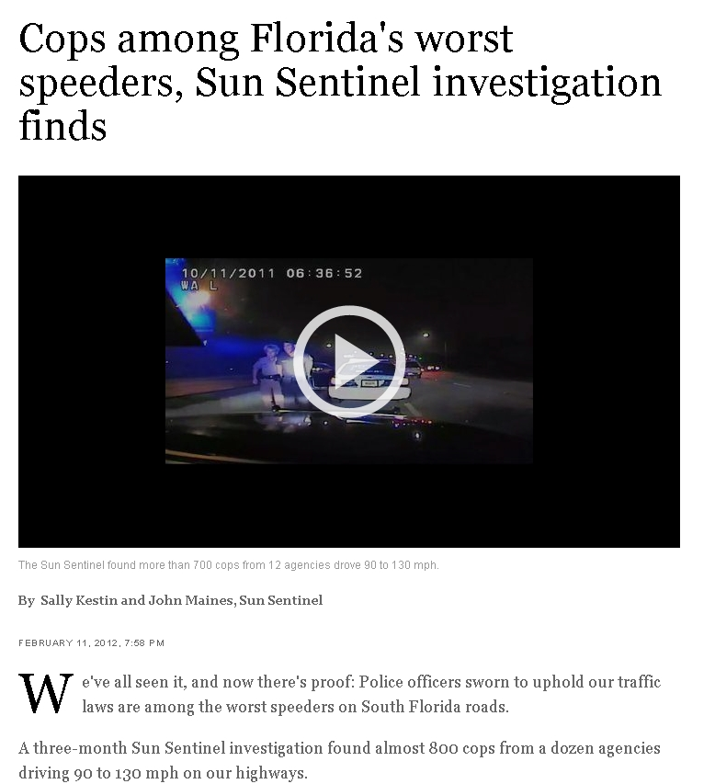
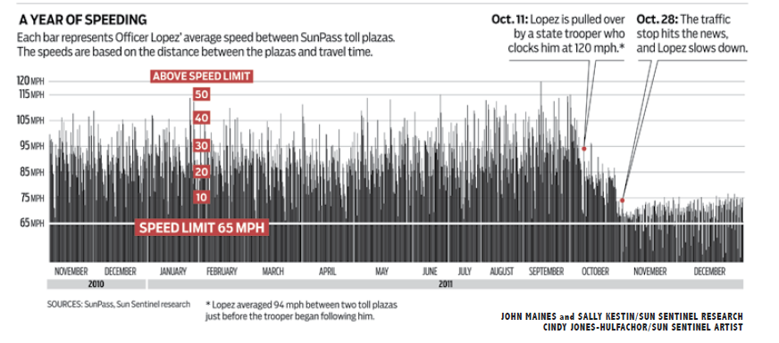
Q: How often are off-duty cops speeding in their cruisers?
Notes:
This is one of several recent Pulitzer Prize public service award winners that relied heavily on data. For this one, the reporters were trying to find out how common it was for off-duty police officers drive well over the speed limit, coming and going to work. It stemmed from a traffic stop where an off-duty Miami officer was clocked going in excess of 120 mph. At first, they thought they might be able to get data from GPS devices in the police cruisers. Agencies either didn’t use them or put up a fight for the data. Then they realized the Florida toll system records the date, location and time down to the hundredth of a second when a car passes through a toll booth. They used a portable GPS device to measure the distance between each toll booth– logging more than 2,500 miles over three counties. They also analyzed crash data to find instances of speeding cops involved in accidents.

Slide 24

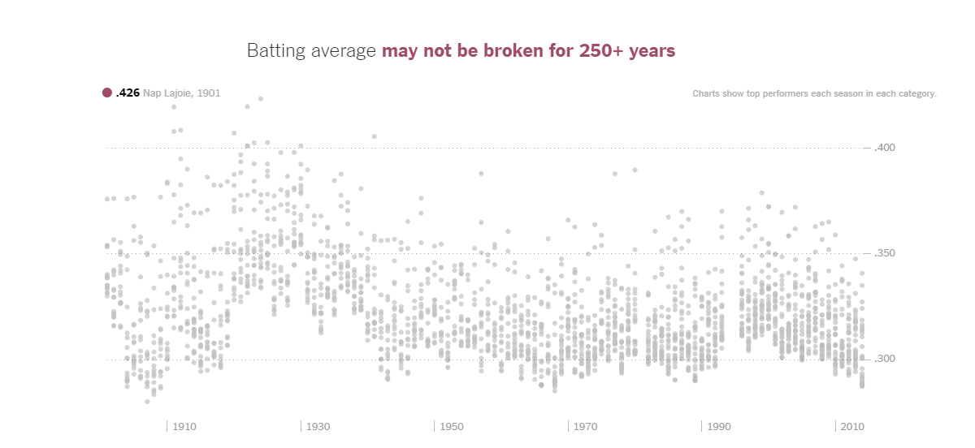
Notes:
By using something called extreme value theory — often used for modeling extreme weather events and floods — we can approximate how many seasons of baseball similar to the most recent era it would take for there to be a 50 percent chance that the single-season records below will have been broken.

Slide 25
NY Times reporter Derek Willis – database of congressional press releases
search for “Ebola” in title
January-June, 2014 | 0
July | 2
August | 8
September | 56
October | 275
Notes:
“Data” doesn’t have to come in rows and columns. NY Times reporter Derek Willis keeps a database of every congressional press release (he scrapes them from the Web) and then he can tap it for various things now and then. Last year as the Ebola crisis was hot news, he wondered what the press releases had to say about Ebola....and his data showed that the discussion among the Congressmen had heated up at pretty much the same pace as the news coverage.

Slide 26
How I see data opportunities

Slide 27
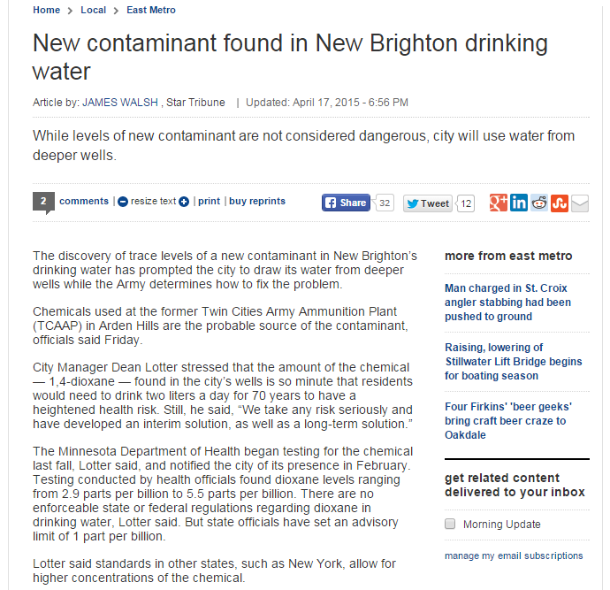
Does the Department of Health have a database of all its test results for all properties – including something that indicates contaminants found?
Where are they testing?
How often are they finding contaminants (and where)?

Slide 28
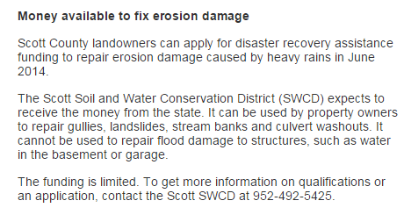
A year or two from now.... where did this money go?
Was it used the way it was supposed to?

Slide 29
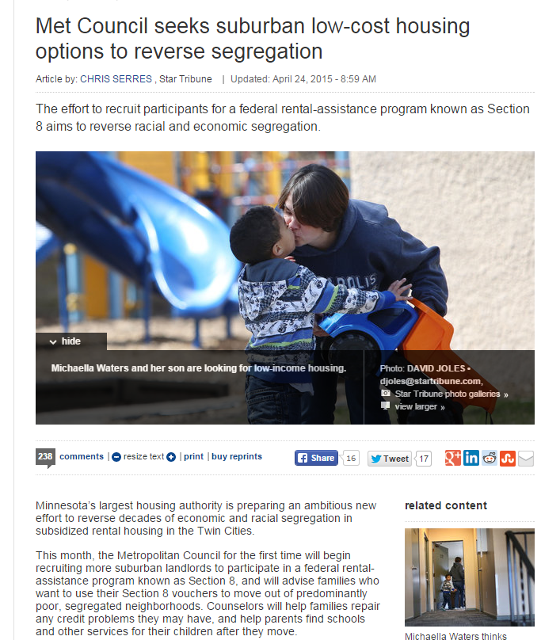
Now...let’s get more detail on this and set a baseline:
Met Council data show that about 25 percent of Section 8 voucher holders in the Twin Cities live in areas of moderate, high or very high poverty.
Later: Get the Section 8 data again and see what has changed

Slide 30
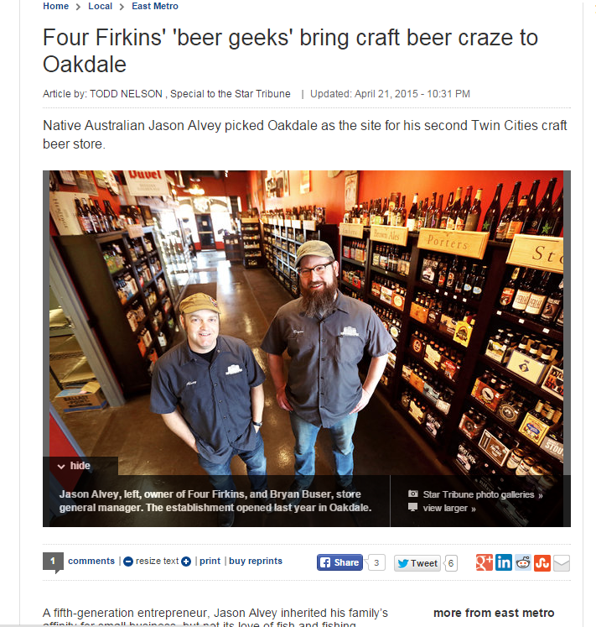
Can we quantify this “beer craze”?
Where are the new breweries?
Are they being inspected?

Slide 31
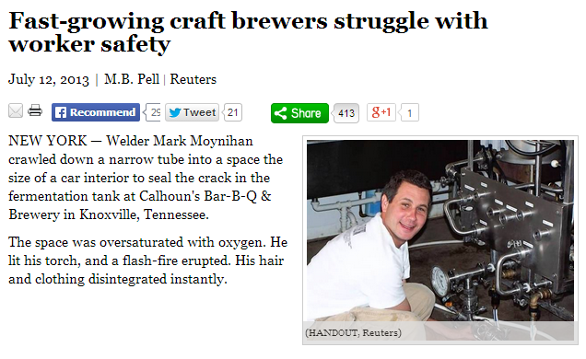
In fact, the inspection story has been done elsewhere.....

Slide 32
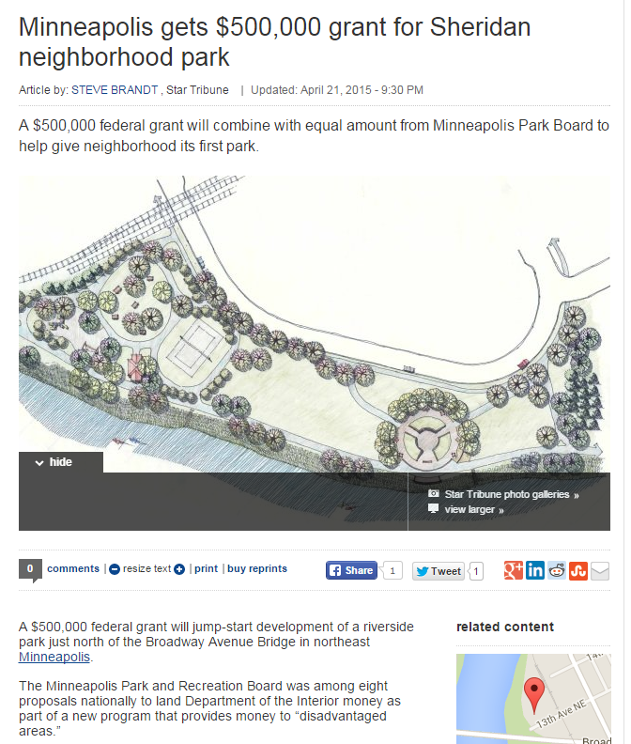
A year or two from now.... can we get detailed breakdown of how this money was spent?
What other federal grant dollars are flowing into Minnesota? And for what?

Slide 33
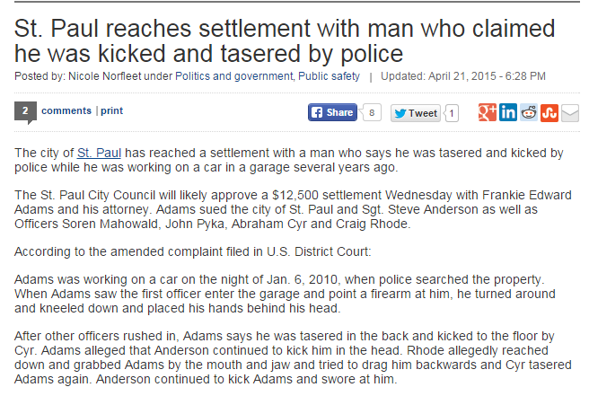
What other settlements has the city made in recent years?
For what? How much?
How does this one compare to the others?

Slide 34
Let’s practice!

Slide 35
Who scored the most touchdowns in his second year as QB?
What data would we need?
Notes:
We need something showing the total touchdowns made by each quarterback each season -- with at least the quarterback name, the season and the number of touchdowns. Maybe this would only be quarterbacks, maybe all players and then there would be a field indicating their position.
How many seasons’ worth of data? Depends what we’re trying to say. Do you want it to cover the entire history of the NFL? Or just back to a certain point in time?
Then we’d need some way of identifying which season was the “second” season for each quarterback. Perhaps we have another file listing each season and the team they played on and some way of indicating which season it was for them in the NFL. Could we use the second season we have data for? Probably not -- what if the QB doesn’t score any touchdowns in his first year? then we wouldn’t have data for that first year

Slide 36
What part of the city has the highest water usage? (The rich folks watering their lawns?)
What data would we need?
Notes:
First we need a way to measure water usage
Then we need a way to determine whether the user is in a rich or poor neighborhood (or something in between).

Slide 37

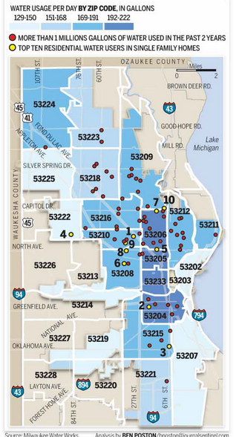
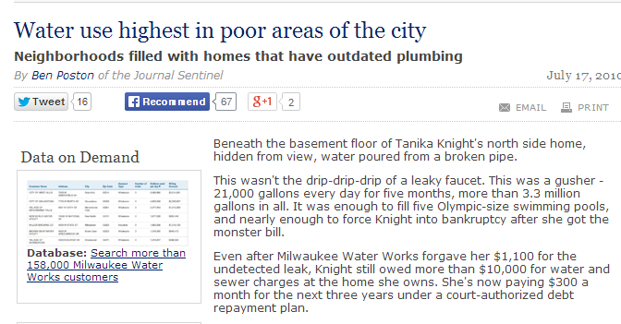
Data: City data on water usage at each address (water billing records) combined with Census data
Notes:
The Milwaukee Journal-Sentinel also asked another interesting question: are there certain parts of the city that use more water than others? (Another way to think of this….are the affluent neighborhoods using a disproportionate share of water because they water their lawns all the time?)
The answer surprised a lot of people: the greatest usage was in the poor areas of the city. Shoe-leather reporting helped them answer why: houses in poor neighborhoods were less likely to have modern toilets, showerheads, etc. that use less water and they were more likely to allow water leaks to go unresolved for longer periods of time.
This is a good example of a story where their question required them to marry two datasets. This is often where you can really break new ground

Slide 38
How to hone your data state of mind
Find data sources on your beat; take them “out for coffee”
Frame story ideas as questions, not nouns
Ask for underlying data when you encounter summary information
Improve how you ask for data; get raw data; get more fields
Think about whether summary data is enough? Does it provide the context you want?
Visualize your data
Notes:
--find the data sources on your beat, take them “out for coffee”; find out how the keepers of the data use it (and don’t use it). Find reports that were based on the data to get a better sense of what you can say from it.
--frame story ideas as questions, not nouns
--when source quotes numbers to you or refers to numbers in a report – ask what the underlying data source is (and perhaps get a copy)
--improve how you go about asking for data (see more below) and what kind of data you get (raw versus aggregate)
--when asking your sources for information, think about whether the one or two numbers, or small chart, that they provided you is really enough. Does it provide the context?
--visualize your data – some people have a hard time with rows and columns of data; and sometimes trends don’t make themselves obvious until you visualize it

Slide 39
Finding ideas
Follow IRE’s Extra! Extra!
#data channel on Slack
What did you write about a year or more ago?
What are the big trends on your beat. Have they been supported by thorough, unbiased analysis?
What are the “myths” on your beat?
Notes:
-look back at stories you wrote 1, 2 or more years ago about initiatives that were launched – is there a way to use data to evaluate how they are doing?
--was there a change a year or more ago that you could measure using data? (example: a change in baseball rules intended to increase the number of homeruns – did it work?)
--what are the big trends on your beat? (what’s being talked about) Have they been supported by thorough, unbiased analysis?
--what “myth” stories exist on your beat. Can you bust them with data?

Slide 40
Requesting data
Do “reporting” or sleuthing about the data before making request. What’s in the data? What’s not?
Don’t ask for “lists” or “reports” – use terms like “machine readable” or “database-friendly format such as Excel or delimited text”
See my handout “Using Minnesota Data Practices Act” for guidelines on writing an official request letter
Notes:
When asking for data, try to think broader than just that one thing you think you want. For example, let’s say you want a dataset listing all the turkey farms in Minnesota and where they are located. That would mean that you’d want, at minimum, a turkey farm name and an address. So what can we do with that? We can map the locations and show where they are geographically. But that’s about it.
But what else does the agency collect about the turkey farms? Does it say how many barns? Does it give a “maximum” number of turkeys it could hold? Does it say anything about the size of the barns? Does it say when the farm was built or first registered with the state? Name of the company that owns it?
If we get some of the other things, we’ve got even more questions we can ask and more flexibility about what we can do with it. We can see which company owns the most farms. Perhaps by using the maximum number of turkeys and the size of the barns we could get some kind of density measurement -- maybe some farms pack their turkeys in more densely than other farms.
The data you want might not exist in the exact FORM that you want. For example, Jeff Meitrodt wanted to find all ag-related deaths in Minnesota. He ask the state if they kept such as list or database. They said no. But then he realized that we have a database of every death in the state, with very detailed fields of information about causes of deaths and occupation of the decedent, even a narrative for some of them. Using the occupation and looking for keywords (like tractor) in the narrative field, he was able to pull together a list of deaths -- it’s possibly a little bit short, but it’s better than nothing.
Lesson to understand: the keepers of the data often don’t analyze their data. Or they just run very top-level reports (i.e. total number of cases handled by child-protection workers, but maybe they don’t know how many came from this part of the county versus that part of the county)

Slide 41
Requesting data continued...
Don’t ask for just a few numbers; get context around the data
Think broader – what other fields might be in the database?
The data you want might not be in the format you expect

Slide 42
Where can I find data?

Slide 43
EVERYWHERE!

Slide 44
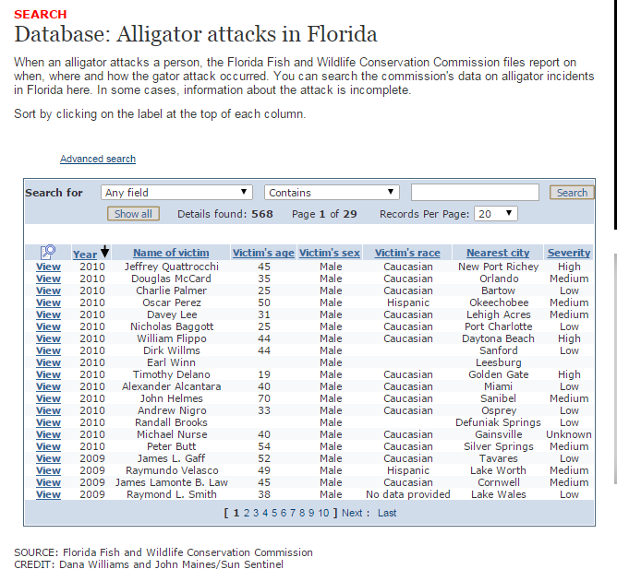
Notes:
Florida has a database of alligator attacks

Slide 45
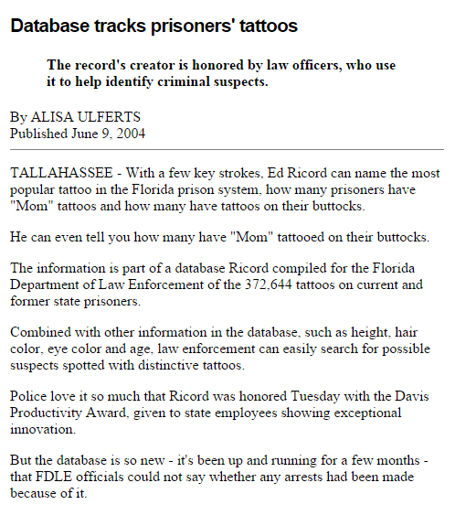
Notes:
The FBI has a database of prisoner tattoos

Slide 46
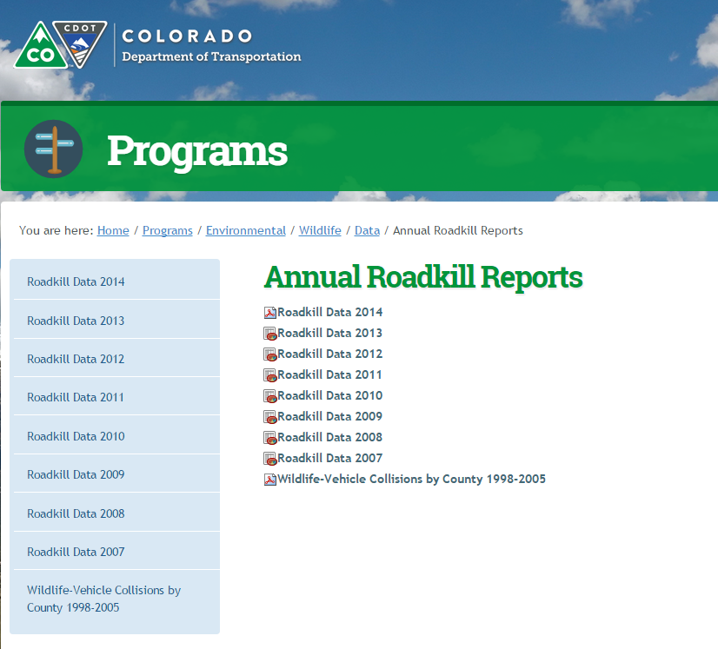
Notes:
Colorado has downloadable data files of roadkill.
A reporter in Washington state did a story from her state’s roadkill database

Slide 47
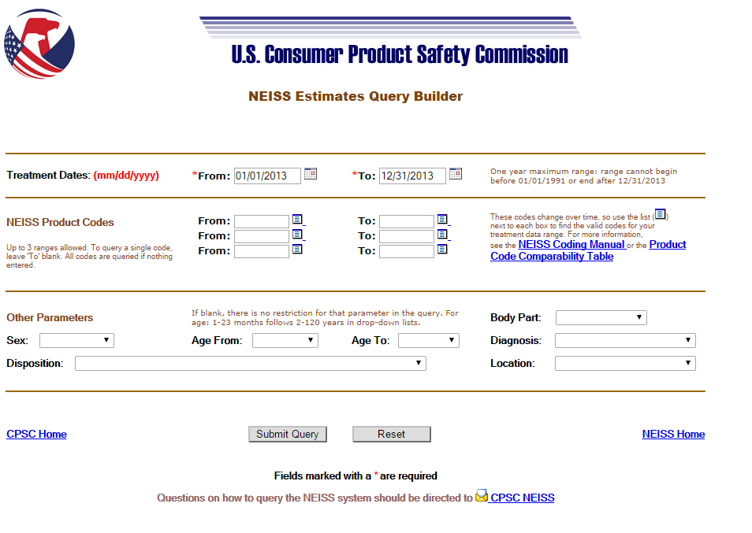
Injured while walking around, talking on cell phone
Notes:
this database has been used to find injuries caused by walking around looking at a cellphone, at least the ones that got people to an emergency room . You can pull up the code for phones and outdoors in public places (so you don't get people tripping over phone cords in their houses) and you might still have to look at each one to weed out things like having a phone booth fall on you (it happens)

Slide 48
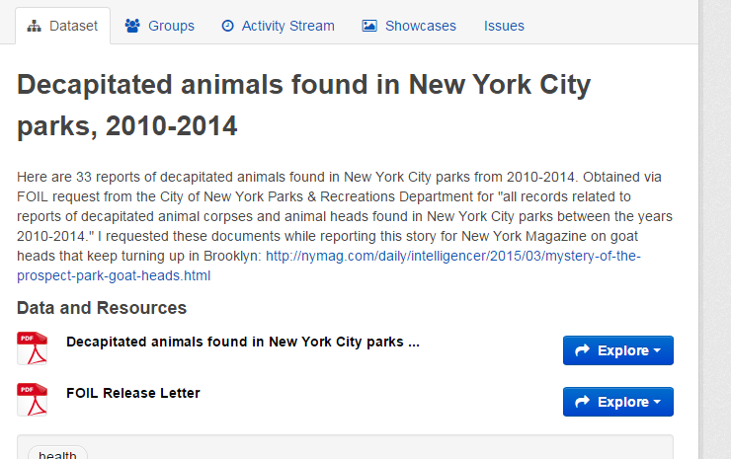
Notes:
NY’s data portal has a database of decapitated animals found in NY city parks.
Somebody else put together a map based on pigeon poop complaints in New York City.

Slide 49
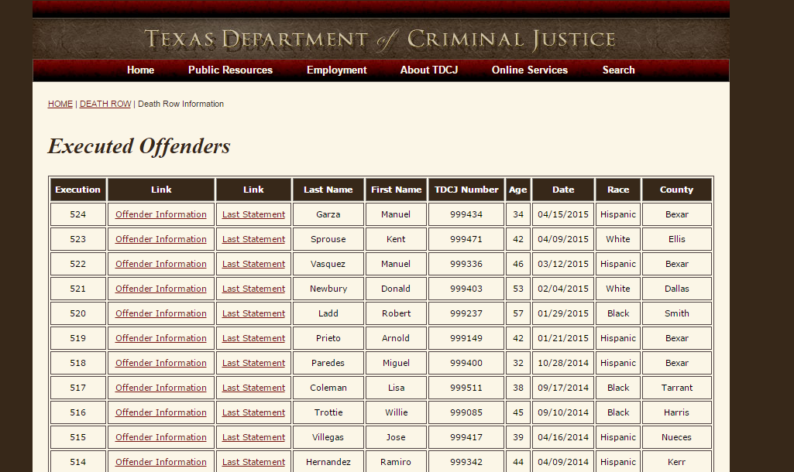
Notes:
A bit morbid but fascinating: Final statements of executed prisoners in Texas:
https://www.tdcj.state.tx.us/death_row/dr_executed_offenders.html
(caveat: they are not from recordings; they are written down by staff and not always verbatim)

Slide 50

Notes:
A TV reporter requested the US Fish & Wildlife’s Database of Seized Non-Live Animal Wildlife Products. They visited the storage facility where the seized items are held --- they saw purses made of bloated bullfrogs, corset made of caiman, the Alexander McQueen haute couture gown, a $2000 Dior reticulated python handbag, a $10,000 scarf made of Tibetan Antelope, the rhino horn, the tiger heads, the elephant tusks, dozens of bottles of pit viper wine (replete with fully intact viper staring at you from inside the bottle), a giant plastic bag of snake gall bladders (seriously) and, um, dried male tiger reproductive organs.

Slide 51
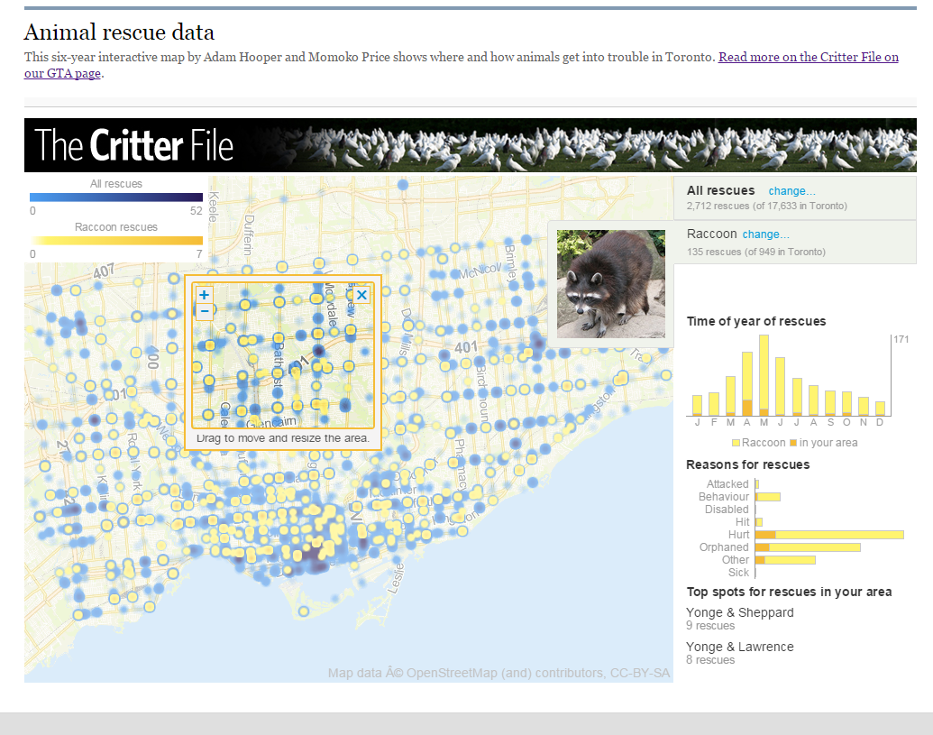
Notes:
Toronto Star regularly gets a database of rescued animals and they turned it into an online visualization.

Slide 52
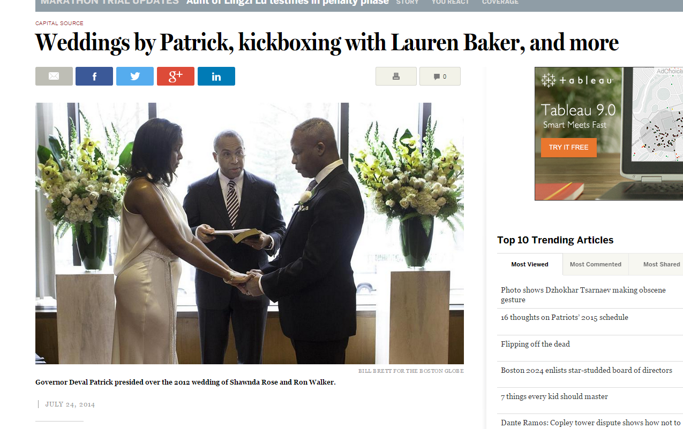
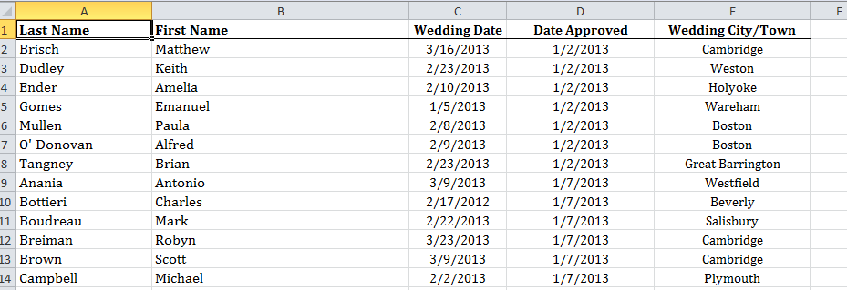
Notes:
Massachusetts has a database of all the people awarded one-day certificates to conduct a wedding.Muckrock got the 2013 list and put it online. https://www.muckrock.com/foi/massachusetts-1/one-day-marriage-designations-all-2013-10032/
Todd Wallack used the broader database to write a small item on all the marriages overseen by then Governor Deval Patrick:
http://www.bostonglobe.com/news/politics/2014/07/24/capitalsource/uFzAb6wjVI27eUftwVArqL/story.html

Slide 53
Last thoughts...
Start small
Take my session on “Using numbers without fear”
Read “Data Literacy” book by David Herzog
Learn how to “bulletproof” your data analysis. Guides are on my data training page: mjwebster.github.io/DataJ
Notes:
--start small – start with some summary data; work your way up to raw data; start with a relatively straightforward story idea and keep it focused

Slide 54
Tapping newsroom data resources
We don’t have enough bandwidth to do everything!
MaryJo and Jeff Hargarten are “partners” in producing any data-driven content.
Contact us as early in the process as possible! The day before/of publication is unacceptable unless it’s big breaking news and crucial that we use data.
Join #data channel on startribune.slack.com

Slide 55
